Slide 1


Introduction to Postman for Microsoft Graph
Sébastien Levert
Senior Product Manager

Slide 2
What is Postman?

Slide 3
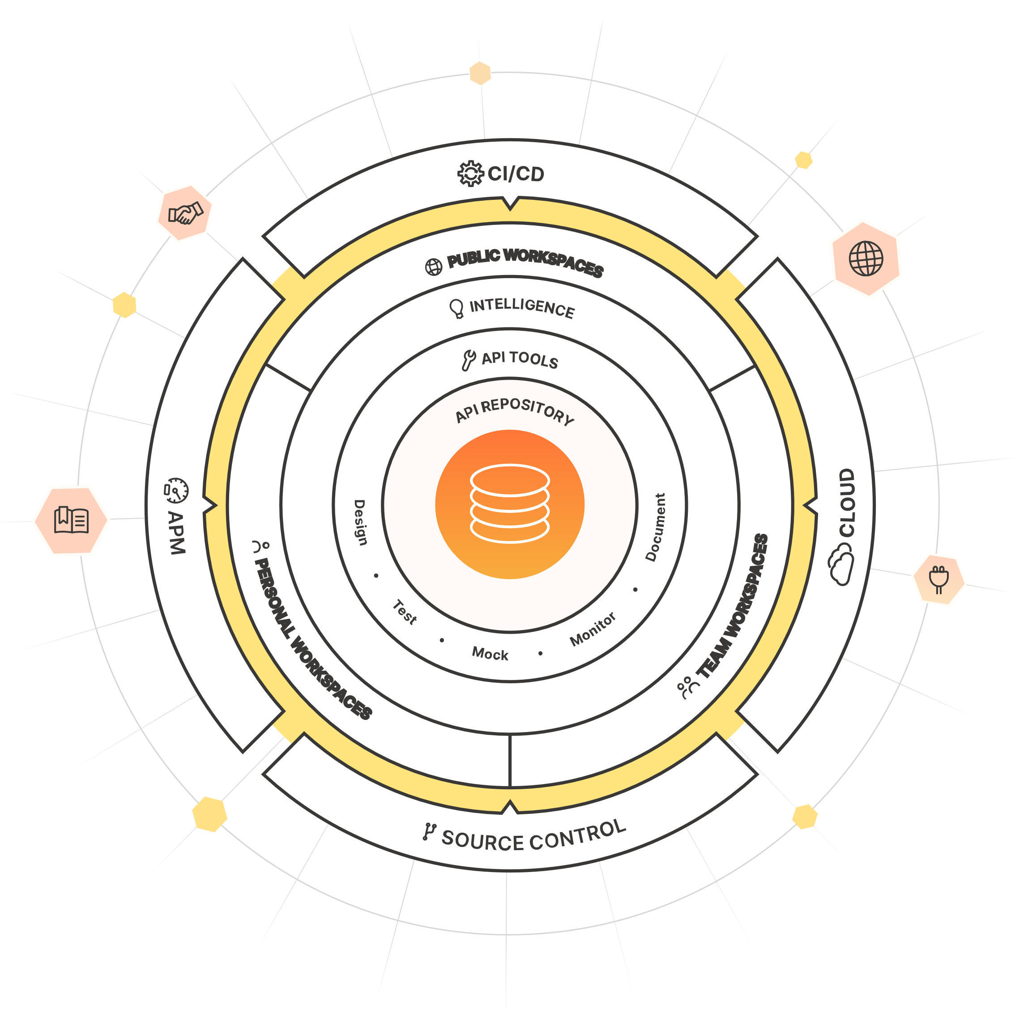
Postman
Postman is an API platform for building and using APIs. Postman simplifies each step of the API lifecycle and streamlines collaboration so that you can create better APIs faster.

Slide 4
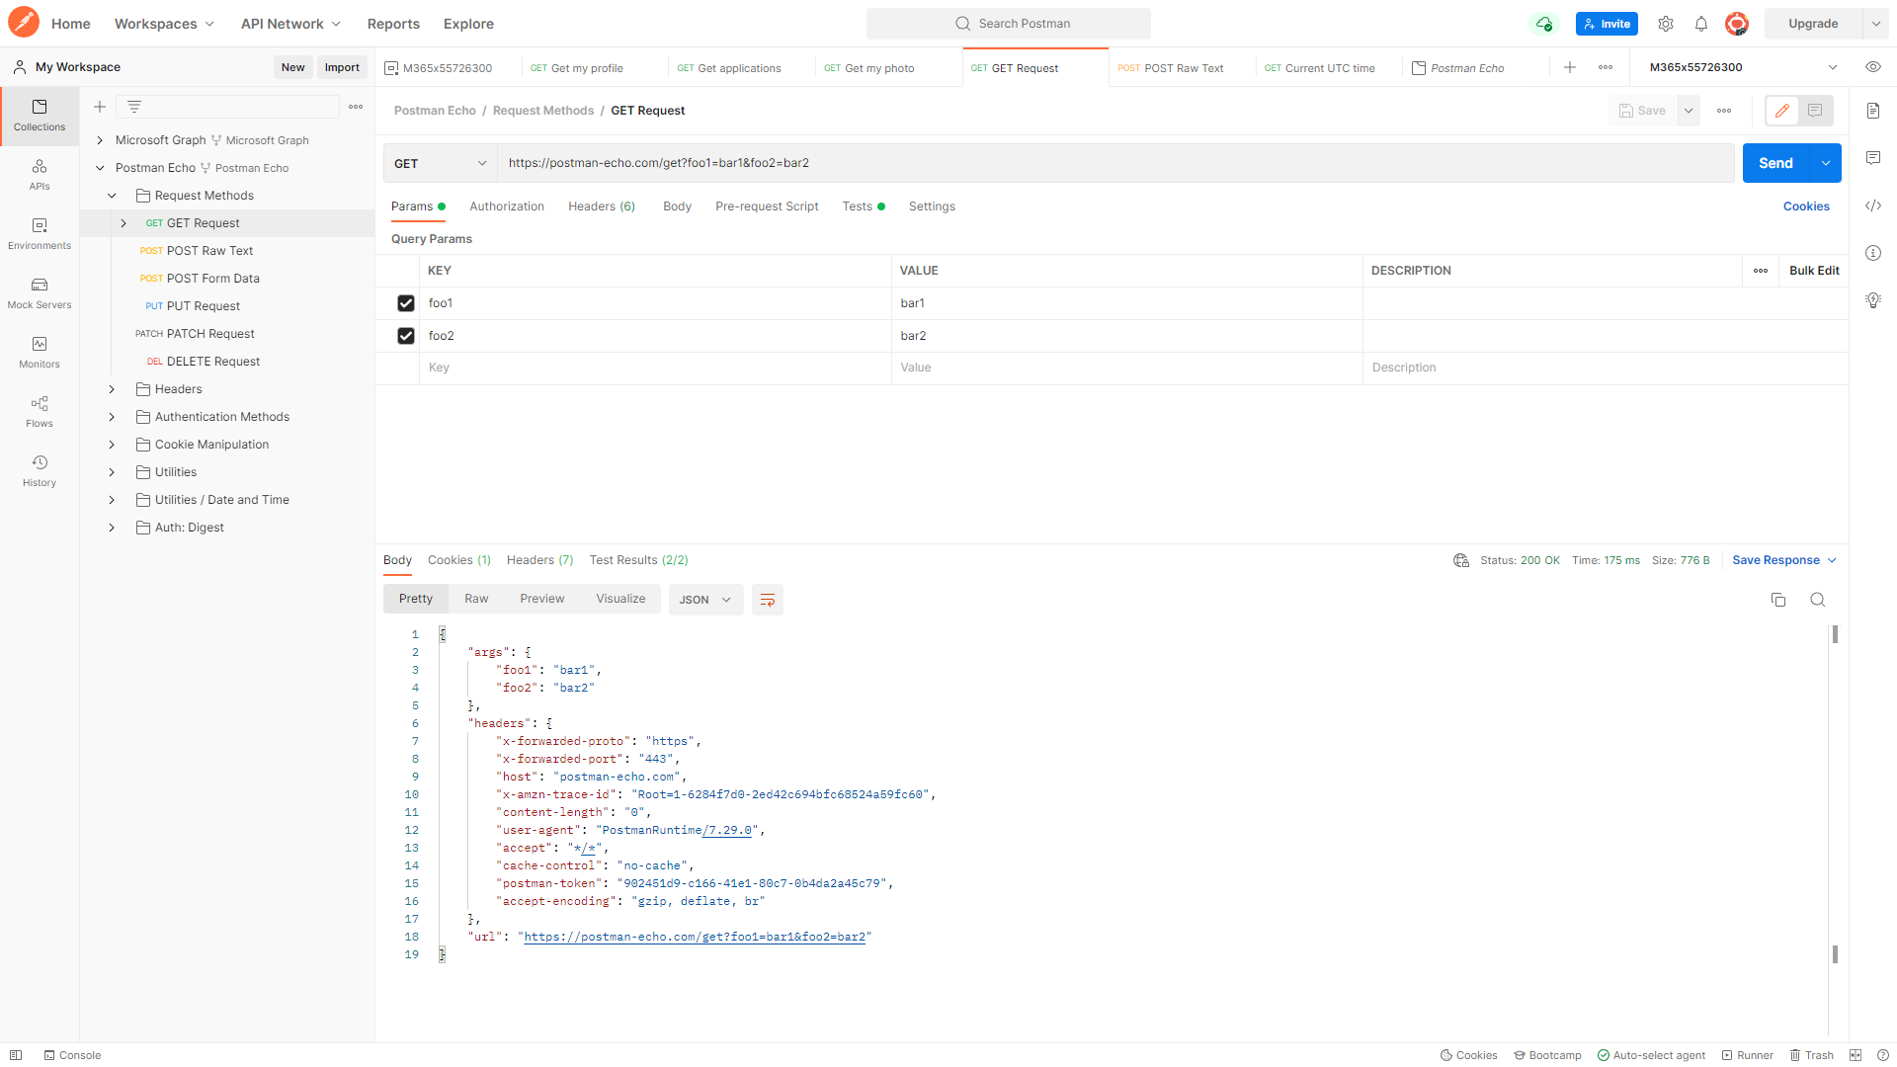

Postman Fundamentals

Slide 5

Postman for Microsoft Graph
Use the Microsoft Graph Postman collection to get started with Microsoft Graph APIs in minutes and get simplified authentication, pre-defined endpoints and environment variables.
Follow the instructions here : https://aka.ms/graph/postman

Slide 6
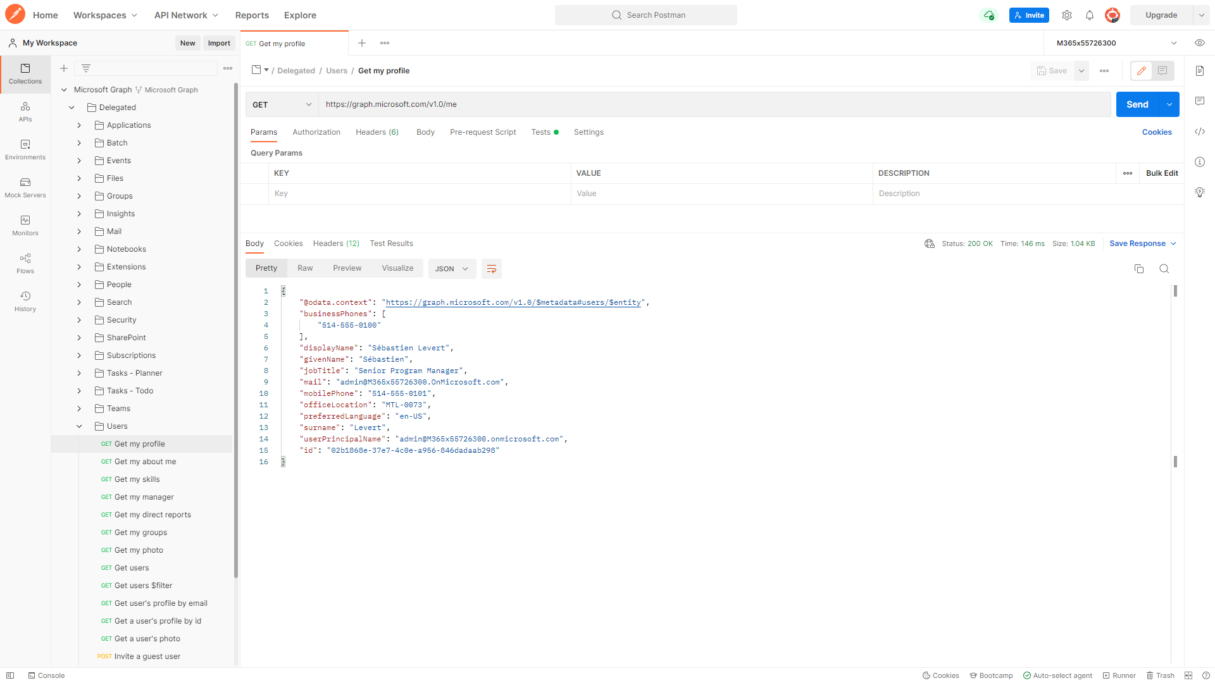
Postman and Microsoft Graph

Slide 7
Thanks !

